Slide 1

IoT Analytics
Wi-fi fingerprinting
Vera Rykalina, July 2020

Slide 2
Challenge
Project Objectives
Use Cases
Data Overview
Datasets
Methodology
Perfomance of Models
Error Estimation
Recommendations
Always Ways To Improve
Outline

Slide 3
Challange
As opposed to outdoor positioning based on GPS satellites, indoor localization with a mobile phone is not a trivial task because of either weak or no access to satellite signals.
Dynamic research to tackle this problem revolves around the use of signals from Wireless Access Points (WAPs) in a building.

Slide 4
Project Objectives
Assess feasibility of Wi-Fi Fingerprinting leverage to determine a person's location in indoor spaces by evaluating multiple machine learning models.
Apply Received Signal Strength Indicators (RSSI) values recorded from multiple Wi-Fi hotspots within the building as input data for modelling.
Compare classification (Accuracy & Kappa) and regression (RMSE & MAE) algorithms and select the best performance.

Slide 5
Use Cases
Shopping Centers
University Campuses
Public Airports
…
Door-To-Door Public Transport Navigation
Blind and Visially Imapaired Community
Home Automation
…

Slide 6
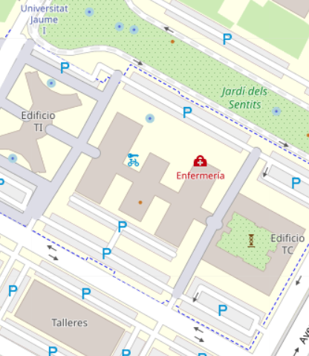
Project Features

Slide 7
Data Overview
Area of 1087703 m²
933 reference points
21049 records: 19938 (training) and 1111 (validation)
Total WAPs 520
Data collection: 20 useres and 25 mobile devices
4 Months difference between training and validation data collection

Slide 8
Datasets
1- TRAIN (TEST) a large database of Wi-fi fingerprints for a multibuilding industrial campus with a location (building, floor, location ID) associated with each fingerprint.
2- VALIDATION containing the expected results already; allows to check the model performance.

Slide 9
Methodology
1 PRE-PROCESSING
Missing values treatment = -105
Data classes conversion = hablar:: convert()
Zero variance exploration & treatment =caret::nearZeroVar()
Duplicates = base::unique()
Descriptive analysis (long format df)
Visualization Tool: ggplo2
Outliers treatment (remove -30 & -90 dBm)
2 FEATURE SELECTION & ENGINEERING
Combining attributes (BuildingFloor)
Creating Principal Components (PCA)
3 PRE-MODELLING
Training dataset partition (75/25)
Cross-validation
4 MODELLING
Caret (RF, KNN, C50, XGB, GBM)
Applying PCA
Tuning tuneGrid()
5 ACCURACY AND CONFIDENCE ANALYSIS
Visualization Tool: ggplo2
6 PREDICTION
Validation dataset

Slide 10
Building
Classification

Slide 11
Classification
Floor

Slide 12
Classification
Model Tuning
Floor

Slide 13
Regression
Longitude
Latitude

Slide 14
Error Estimation

Slide 15
Recommendations
Solid WAP locations
Actualization of WAP changes: installation of new and remove of old
Location of WAPs at buiding cornes (training dataset)
Time series data as approch (input: last position, speed limit constraint)
Reasonable accuracy vs computing power
Disctribution of WAPs can be imprived (better coverage)

Slide 16
Always Ways To Improve
Synchronization of training and validation datasets? (timestamps)
Building-Floor feature engineering
Trying out WAPs vs PCAs
Explore outliers in predicted locations (plotly)

Slide 17
Always Ways To Improve
Smart resolving of signal overlaps → Lon/Lat check (figure)
Leverage of non-caret algorithms
Normalization (other methods)

Slide 18
Thank you!

